Slide 1
Security In Modern Computing Environment :
Cloud
and
Fog Computing

Slide 2
Introduction to Fog Computing
Cisco coined a new term called the fog computing which is the extension of cloud computing towards the network edge to enable cloud-things service continuum.
Principle- Data processing and communication should be served closer to the data sources.
Fog computing enables smart applications to perform their processing on network devices which can be routers, gateways or switches rather than sending data to cloud data centers .

Slide 3
Architecture of Fog Computing Environment
The lowest layer of this architecture contains the data generation devices which can be sensors, RFID tags, cameras, Internet of Things (IoT) devices and actuators.
Middle layer of the architecture consists of the network devices used to send the data from lower layer devices to the cloud computing infrastructure.

Slide 4
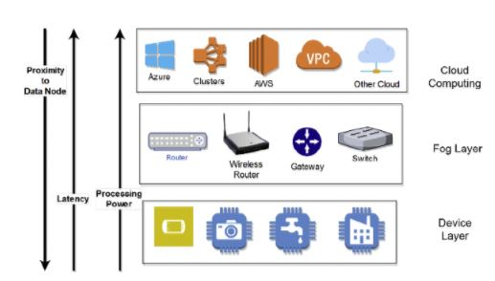

Slide 5
The upper layer is the cloud layer which consists of virtual machines which can be provisioned from any of the cloud service provider
If fog layer does not have free computational resources then it can send the re-quests directly to the cloud infrastructure.

Slide 6
Security in Fog Computing
Device security is one of the major challenges for successful implementation of Internet of Things and fog computing environment in current IT space.
If edge device is hacked, it can get false input and provide false output data, and formulate bad results which can affect the performance of whole application. Hacked device can also be used to share data and results with competitive companies or radical groups involved in unwanted activities.

Slide 7
Types of attacks in fog computing
There are two types of possible attacks-
Unauthenticated Attacks -If the edge device is unauthenticated and tries to attack the device layer or cloud layer then this attack is called unauthenticated attack or outside attack
Unauthorized Attacks- if the edge device which attacks the fog layer or cloud layer is authenticated and it is inside the trusted network of application then it is called unauthorized or inside attack.

Slide 8
Attack detection in fog computing
Attack detections can be either signature based or anomaly based schemes.
The signature based solution matches the incoming trafﬁc against the already known attack types in the database (high accuracy of detection and low false alarm rate).
Anomaly based scheme caters for attack detection as a behavioral deviation from normal trafﬁc.

Slide 9
Introduction to Deep learning
Deep learning in security learns the true face (attack or legitimate) of cyber data on even small variations or changes, indicating the resiliency of deep learning to small changes in network data by creating high level invariant representations of the training data.
With Machine Learning, software can gain the ability to learn from previous observations to make inferences about both future behavior, as well as guess what you want to do in new scenarios.

Slide 10
Security using Deep Learning
The application of deep networks has already been successful in big data security.
this indicates that fog computing can also be use for the attack detection approach because a massive amount of data produced by IoT devices
Attack detection could beneﬁt from a pre-training scheme of stacked autoencoders for automatic feature learning.

Slide 11
One way to apply stacked autoencoder is to train a model with a mix of normal/attack sample of the unlabeled network so that the model identiﬁes patterns of attack and normal data by a self-learning scheme. The detected patterns are mapped to labeled test data as attack and normal.

Slide 12
Attack Detection using deep learning
Our Work
(1) To design and implement deep learning based attack detection mechanism.
(2) Used self taught deep learning scheme in which supervised feature learning has been employed on training data.
(3) The learnt features were applied to the labeled test dataset for classiﬁcation into attack and normal.

Slide 13
Data set description
We used NSL-KDD intrusion dataset which is available in csv format for model validation and evaluations. The original dataset consists of 125,973 records of train and 22,544 records of test, each with 41 features such as duration, protocol, service, ﬂag, source bytes, destination bytes, etc.

Slide 14

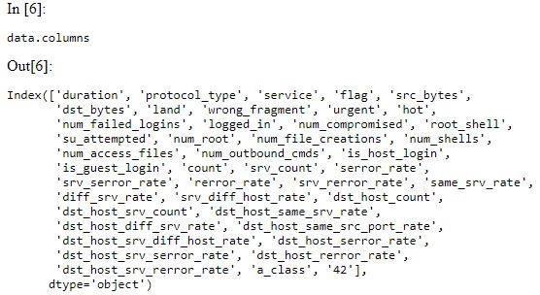

Slide 15
Our Approach
ToolS/Framework Used-Anaconda, Spider IDE, Keras, Sklearn .
Anaconda is complete development environment with over 300 Python packages. Conda is a powerful package manager and environment manager .
Keras: It is a high-level neural networks API, written in Python and capable of running on top of TensorFlow, CNTK, or Theano

Slide 16
core data structure of Keras is a model, a way to organize layers. The simplest type of model is the Sequential model, a linear stack of layers.
Before training the network, categorical features have been encoded into discrete features.

Slide 17
Labelencoder( ) is a utility function to help normalize label Such that they contain only values between 0 and n classes-1.
ﬁt transform() joins these two steps and is used for the initial ﬁtting of parameters on the training set , and it also returns a transformed set.

Slide 18
MinMaxScaler Transforms features by scaling each feature to a given range. This estimator scales and translates each feature individually such that it is in the given range on the training set.
k-Fold Cross Validation The gold standard for machine learning model evaluation is k-fold cross validation. It provides a robust estimate of the performance of a model on unseen data.

Slide 19
It does this by splitting the training dataset into k subsets and takes turns training models on all subsets except one which is held out, and evaluating model performance on the held out validation dataset.
The process is repeated until all subsets are given an opportunity to be the held out validation set. The performance measure is then averaged across all models that are created.

Slide 20


Accuracy :

Slide 21
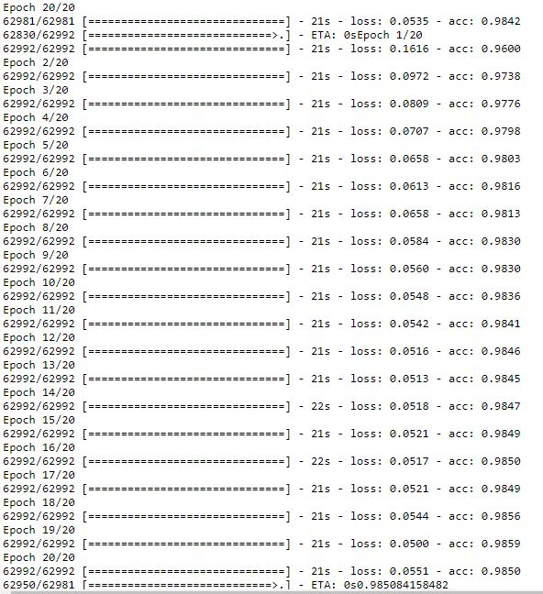

Slide 22
Conclusions :
Though fog computing design can give the required service necessities and distributed resources, robust security mechanisms are required resources to shield IoT devices.
The fog nodes are answerable for training models and hosting attack detection systems at the edge of the distributed fog network.

Slide 23
Conclusions :
Deep learning is a model with multi-level layer structure. From down to above is a process of the unsupervised learning and from top to bottom is supervised learning process .
Overall accuracy of deep models is better than shallow
Model.
In short, "shallow" neural networks is a term used to describe NN that usually have only one hidden layer as opposed to deep NN which have several hidden layers

Slide 24
Made By-
Lokesh Kaushik (14ucs059)
Harsh Thakur (14ucc011)
Siyaram Saurabh Dwivedi (14uec104)
Sudhanshu Singh (14ucs128)

Slide 25
THANK YOU!

